Slide 1


CT216
LDPC DECODING FOR 5G NR
Group 5
Under the Guidance of: Prof. Yash Vasavada
Mentor T.A. : Madhav Jivani

Slide 2
HONOR CODE
We declare that
→ The work that we are presenting is our own work.
→ We have not copied the work (the code, the results, etc.) that someone else has done.
→ Concepts, understanding and insights we will be describing are our own.
→ We make this pledge truthfully. We know that violation of this solemn pledge can carry grave consequences.

Slide 3
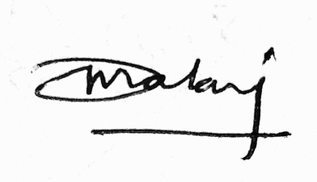
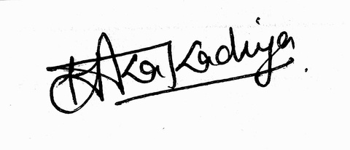
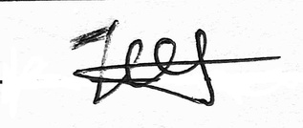


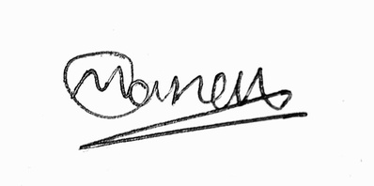

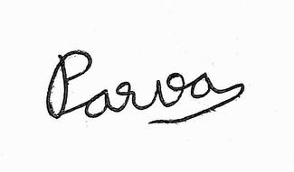

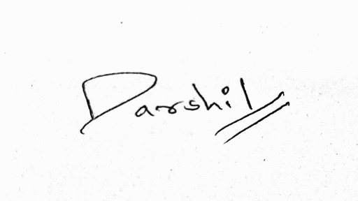
MEMBERS
ID | Name | Signature
202301046 | Dhruv Malani
202301047 | Jeel Thummer
202301049 | Ramoliya Shivam S.
202301050 | Siva Suhas Thatavarthy
202301051 | Yug Patel
ID | Name | Signature
202301052 | Harsh Kakadiya
202301053 | Karan Makasana
202301054 | Manav Kalavadiya
202301055 | Parva Raval
202301056 | Darshil Gandhi

Slide 4


CONTENT
Introduction
1
6
Conclusion
2
5
Encoding
Results
3
4
Soft Decision Decoding
Hard Decision Decoding

Slide 5
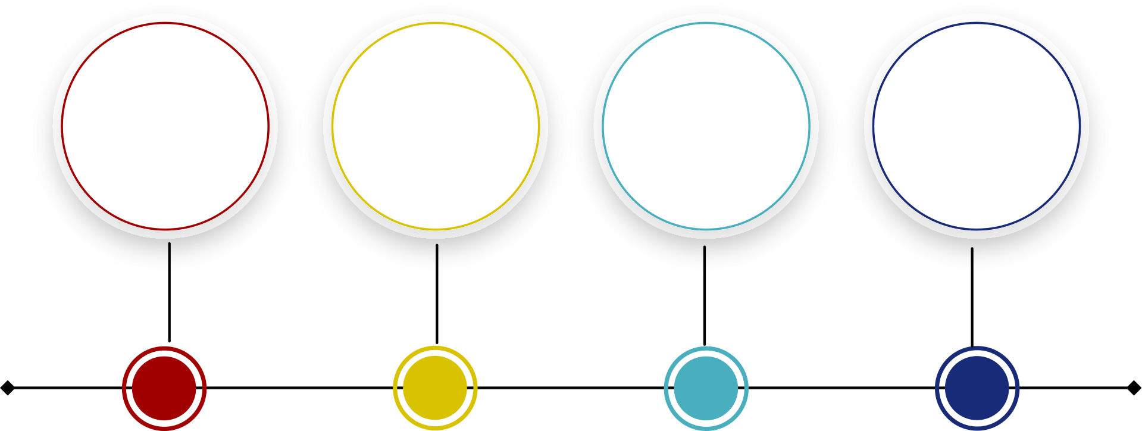
INTRODUCTION
Low-Density Parity Check (LDPC) codes represent a class of error correcting codes that may be employed for providing error correction of transmission errors in communication systems
They maintain low decoding complexity due to their sparse matrix structure.
Using LDPC codes, channel capacities that are close to the theoretical Shannon Limit can be achieved.
1962
1990s
2000s
2016-18
LPDC INTRODUCED BY
ROBERT GALLAGER
REDISCOVERY AND ACHIEVEMENT OF SHANNON LIMIT
INDUSTRIAL WORLD ADOPTION
INTEGRATION OF LDPC INTO 5G NR

Slide 6
FLOW CHART
RANDOM MESSAGE
BASE MATRIX
PARITY CHECK MATRIX
H MATRIX
ENCODED MESSAGE
NOISE
RECEIVED BITS
RECEIVED MESSAGE
AWGN
BPSK
HARD DECODING
SOFT DECODING

Slide 7
ENCODING

Slide 8
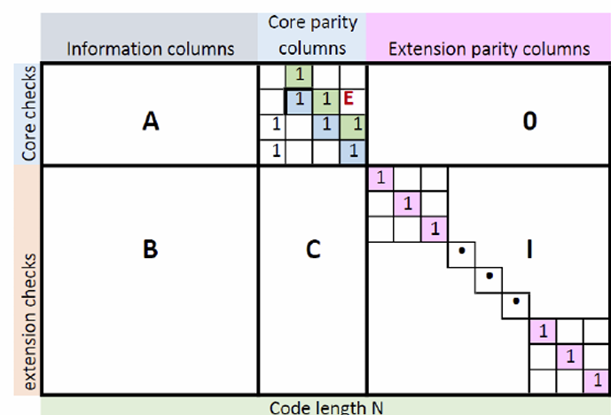
BASE GRAPHS
LDPC uses two standard base matrices:
BG1: Size 46 × 68
BG2: Size 42 × 52
These are sparse matrices – mostly 0’s with few non-zero entries
The base matrices are expanded into the full parity-check matrix (H) using an expansion factor Zc
The number of message bits is determined by k=m-n where the base graphs are of size m x n. Thus, BG1 has a maximum of 22 bits. BG2 has a maximum of 10 bits.
A general base graph representation

Slide 9
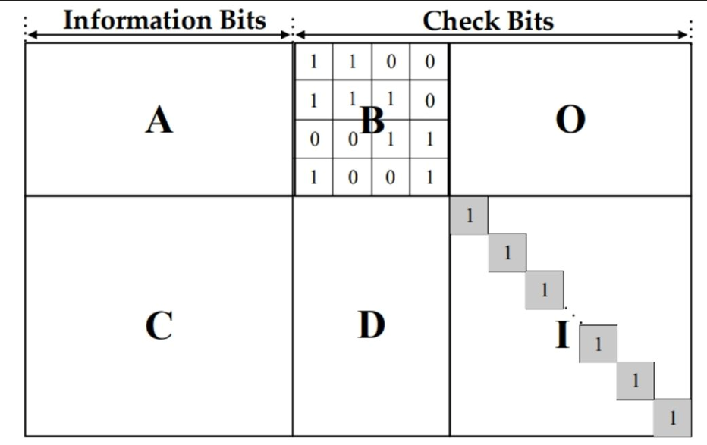
STRUCTURAL REGIONS OF BASE GRAPHS
Each base matrix is conceptually divided into six logical regions to distinguish between:
High density / low density
Information bits / parity bits
Region Breakdown:
Base Graph Region A Region B Region C Region D Region I Region O
BG1 (46×68) 4×22 (A) 4×4 (B) 4×42 (C) 42×22 (D) 42×4 (I) 42×42 (O)
BG2 (42×52) 4×10 (A) 4×4 (B) 4×38 (C) 38×10 (D) 38×4 (I) 38×38 (O)
A: High-density region (important for data mixing)
B: Double diagonal structure – crucial for efficient systematic encoding
C/D: Low-density sections – offer decoding sparsity
I: Identity matrices – help preserve structure in expansion
O: All-zero matrices – act as “gaps” between regions

Slide 10
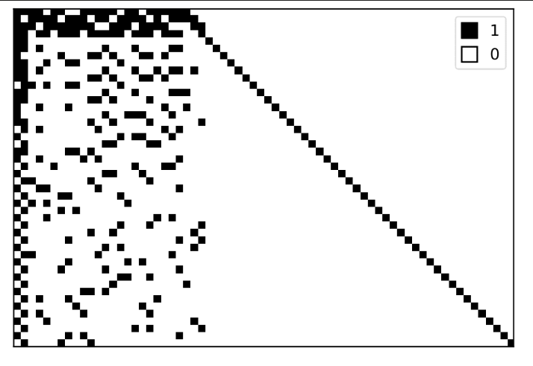
A example representation of Base Graph 1 with size 46 X 68

Slide 11
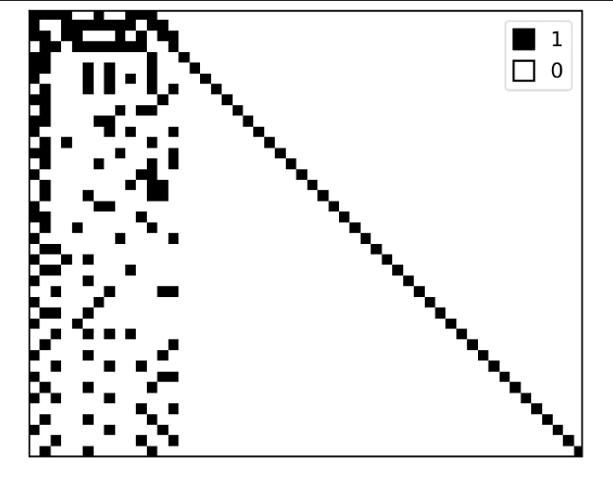
A example representation of Base Graph 2 with size 42 X 52

Slide 12
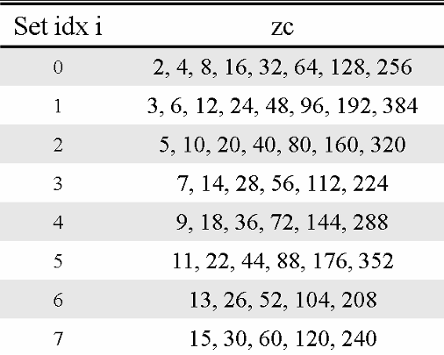
Expansion of Matrix
Each entry from the base matrix expands into a Zc × Zc matrix:
−1 → Zero matrix
0 → Identity matrix
k (positive integer) → Zc × Zc identity matrix cyclically right-shifted by k
This process “blows up” the base graph into the full parity-check matrix H
Each base matrix entry the values are from -1,0,1,2,3,4 ..... Zc-1
Values mentioned in the figure are the expansion values that can be taken by the base graphs

Slide 13
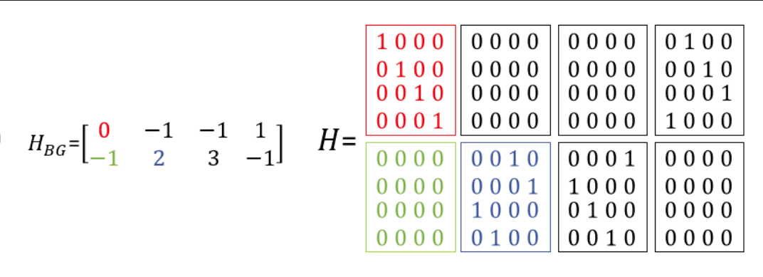
PARITY CHECK MATRIX (H)
LDPC codes are defined by a sparse matrix H, constructed from base matrices using expansion factor Zc
A example for expansion from Base Matrix with expansion factor : 4

Slide 14
CODE RATE AND RATE MATCHING
Defined as the ratio of message bits to total transmitted bits
Rc = K/N
K: Message bits
N: Total transmitted bits
Rate Matching:
It is the process of adjusting the number of bits transmitted to match the desired code rate and channel capacity.
It allows flexible adaptation to varied data rates, block sizes, and channel conditions.
Even if the LDPC encoder always generates the same number of output bits , rate matching helps us transmit only as many as needed.
There are some rate matching techniques
Puncturing
Shortening

Slide 15
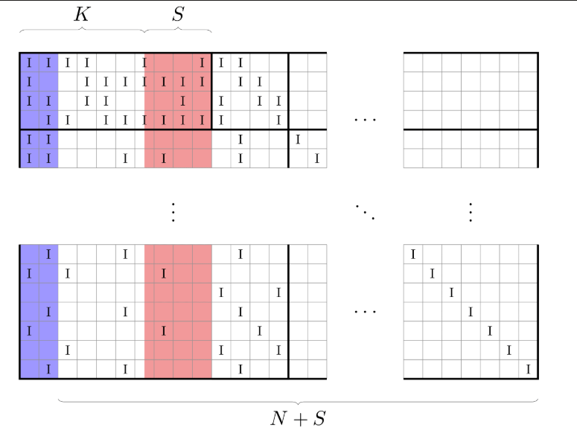
MESSAGE BIT SHORTENING
Set some message bits to zero and do not transmit them.
The S shortened bits are not transmitted, effectively increasing K and N, which results in a decreased Rc
Decoder treats shortened bits as known-zero bits.
Implemented by removing those columns from the H matrix
Decoding Behavior:
Corresponding columns in H are disregarded

Slide 16
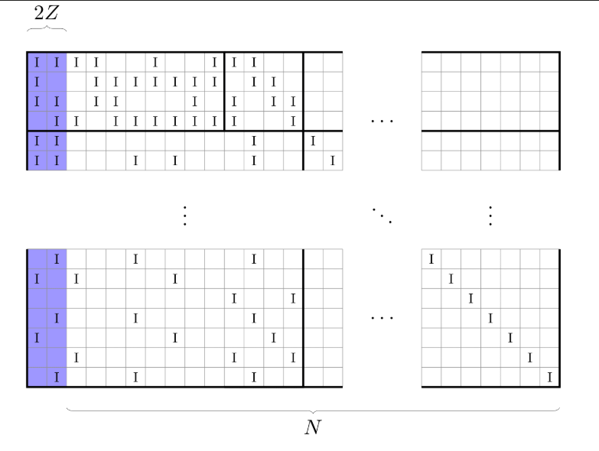
MESSAGE BIT PUNCTURING
Skip transmitting certain encoded bits of the H matrix
At the receiver, missing bits are filled with zeros or soft-value 0 during decoding.
The first 2Z message bits are never transmitted
These bits are highly connected → prone to cause decoding errors
Helps avoid error propagation without changing Rc
These bits are included in H during decoding

Slide 17
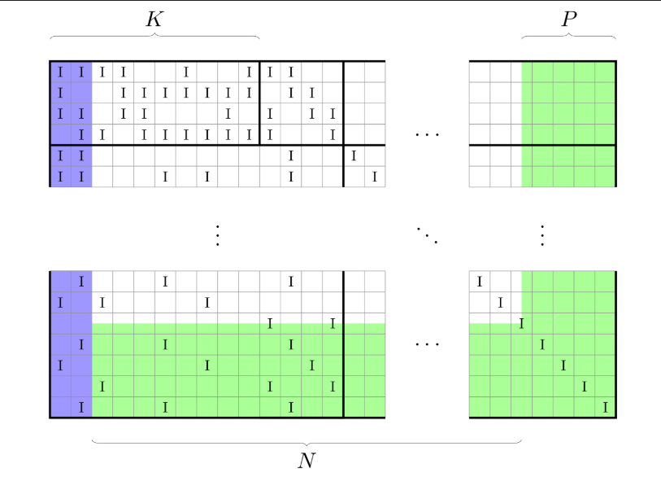
PARITY BIT PUNCTURING
Certain parity bits are not transmitted from the H matrix
Reduces total bits N, resulting in a higher code rate
Corresponding columns in H are disregarded during the decoding
Alternatively, set r = 0 for punctured parity bits

Slide 18
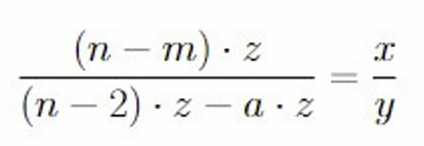
CODE RATE MATCHING FORMULA
Suppose you have a base matrix of size m x n and an expansion factor of z. So the possible length of the codeword will be n*z.
Out of these n*z bits, the first 2z are always punctured. So we have (n-2)*z bits left.
Suppose you want to achieve an overall code rate of x/y
Assume that you puncture a*z bits out of the available (n-2)*z bits.
Number of message bits = (n-m) * z.
From the equation shown, we can compute the number of parity bits required
So, the required size of H matrix is
Number of rows = Number of parity bits which we get from the equation
Number of columns = Number of columns from equation + 2
derived formula of code rate matching

Slide 19
RATE MATCHING EXAMPLE
Example: We want Code Rate = 3/4 with Base Matrix 46 × 68
Suppose we have a 46 X 68 Base matrix and we want a code rate of 3/4.
So, n = 68, m= 46, x = 3, y = 4.
Putting these values in the previous equation and solving for a, we get a = 49
So, now we have to transmit 66z - 49z = 17z bits in all.
Out of these 17z bits, 13z are message bits.
Parity bits sent: 17z−13z=4z
Rows used: Number of parity bits = 4
Columns used: Transmitted bits = 17+2=19
for a code rate of ¾ we use a 4 x19 submatrix from the full 46 X 68 base matrix

Slide 20

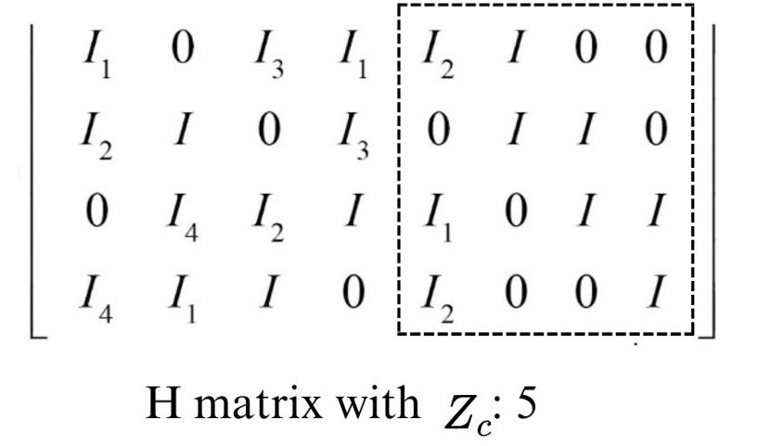
ENCODING USING BASE MATRIX
We exploit the structure of the base matrix to do the encoding
The main idea behind the decoding is that all the parity bits greater than equal to 5 can be obtained simply by solving a linear equation because of the structure of the matrix
To find the first four bits, we need to solve 4 equations simultaneously. This calculation is made easy due to the double-diagonal structure of the matrix.
We will consider an example to understand the encoding:
We have a message vector m = [m1 m2 m3 m4 m5]
4 parity bits are added to this vector which are [p1 p2 p3 p4]
Codeword = [c1 c2 c3 c4 c5 c6 c7 c8 c9]
double diagonal stucture

Slide 21
Equations obtained:
I₁v₁ + I₃v₃ + I₁v₄ + I₂v₅ + Iv₆ = 0 -Equation 1
I₂v₁ + Iv₂ + I₃v₄ + Iv₆ + Iv₇ = 0 -Equation2
I₄v₂ + I₂v₃ + Iv₄ + I₁v₅ + Iv₇ +Iv₈ = 0 -Equation 3
I₄v₁ + I₁v₂ + Iv₃ + I₂v₅ +Iv₈ = 0 -Equation 4
Adding all four equations:
I₁v₅ = I₁v₁ + I₂v₁ + I₄v₁ + Iv₂ + I₄v₂ + I₁v₂ + I₃v₃ + I₂v₃ + Iv₃ + I₁v₄ + I₃v₄ + Iv₄
We know that [v₁ v₂ v₃ v₄ v₅ v₆ v₇ v₈ v₉] = [m₁ m₂ m₃ m₄ m₅ p₁ p₂ p₃ p₄]
So, rewriting the equation, we get:
I₁p₁ = I₁m₁ + I₂m₁ + I₄m1 + Im₂ + I₄m₂ + I₁m₂ + I₃m₃ + I₂m₃ + Im₃ + I₁m₄ + I₃m₄ + Im₄
From here we can get p₁.
Substitute it in equation1 to get p₂ and solve so on to get all the 4 parity bits
The encoded message must satisfy the equality H*c = 0.
After calculating the first 4 parity bits it is easy to calculate the other parity bits as for the each column only one parity bit is present others get 0 (after multiplied)
After getting the parity bits we need to do BPSK and add noise using the AWGN channal

Slide 22
BPSK MODULATION
Binary Phase Shift Keying (BPSK) maps bits to voltages:
Bit 0 → +1 volt
Bit 1 → −1 volt
Mapping formula:
s = 1 − 2b, where b is the bit and s is the modulated signal
Ensures maximum symbol separation for better noise resistance

Slide 23
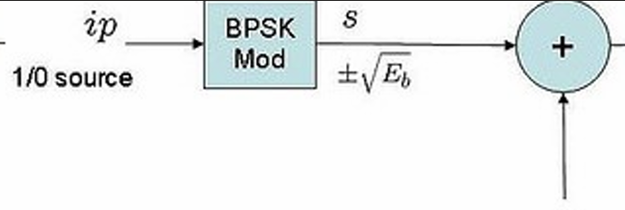
AWGN CHANNEL
Simulates real-world noise using Additive White Gaussian Noise (AWGN)
Noise power determined by SNR:
γ = Eₛ / N₀, where Eₛ is signal energy
σ² = 1 / γ, noise variance
Received signal:
r = s + u, where u = σ × uₛ
uₛ ~ N(0, σ) (standard normal noise)
AWGN affects BPSK symbols, testing decoder robustness
schematic of bpsk and awgn channal

Slide 24
DECODING

Slide 25
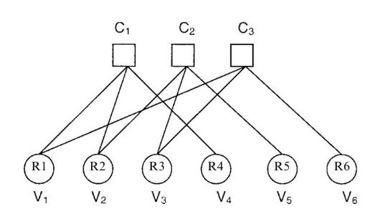
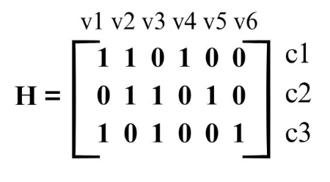
DECODING TANNER GRAPH
The Parity Check Matrix H can be represented by a Bipartite Graph containing 2 types of nodes :- (i) Variable nodes or Bit nodes (VN’s) , (ii) Check nodes(CN’s) to check parity , this is called as Tanner graph .
A Sample Parity Check Matrix H
Corresponding Tanner Graph of given H

Slide 26
DECODING ALGORITHMS
Hard Decision Decoding
Soft Decision Decoding
Operates on bits(0/1)
Bit Flipping Algorithm
Weighted BF Algorithm
and More Complexities in BF Algorithm
Operates on LLRs (Real Valued Beliefs)
Belief Propagation Algorithm
Min-Sum Algorithm
Layered Decoding
Neural Decoding

Slide 27
HARD DECISION DECODING
Bit Flipping Algorithm
Hard Decision Performance:-
ĉᵢ = 0 if rᵢ > 0
1 else
rᵢ is the received value from the channel
Convert all the soft values to binary by thresholding at 0:
If rᵢ is positive (closer to +1), assume bit was 0
If rᵢ is negative (closer to −1), assume bit was 1
Steps:-
Compute the syndrome vector, s = H * ĉ^T mod 2
For each bit:
Check if it's part of many unsatisfied parity checks, and flip it if found.
Repeat until:
Syndrome = 0 (all parity checks satisfied) or Maximum iterations reached

Slide 28
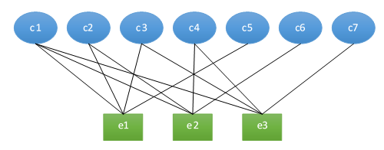
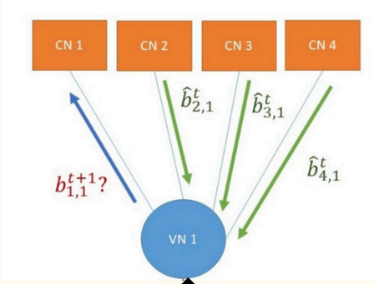
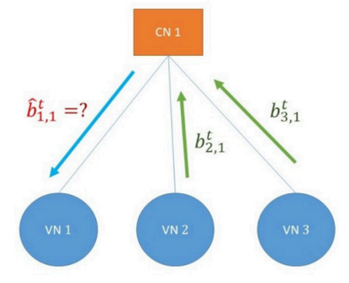
HARD DECISION DECODING
Bit Flipping Algorithm
Message from VNi to CNj
Each variable node VNi​ transmits its current hard-decision value to all connected check nodes CNj based on the parity-check matrix H.
Message from CNj to VNi
Each check node CNj evaluates the local parity constraint and sends a binary indication to each connected variable node VNi​, indicating it might be incorrect.
Bit-Flipping Criterion at VNi​
If more than 50% of the connected check nodes CNj indicate a parity violation, the bit value of VNi​ is inverted, this process iterates until convergence or until maximum iteration limit is reached.

Slide 29
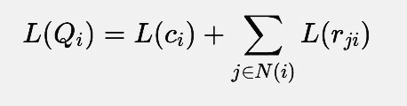
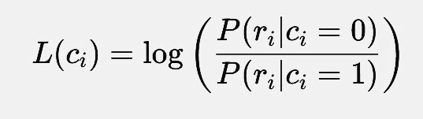
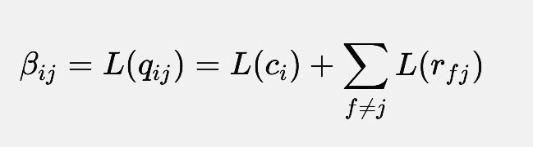
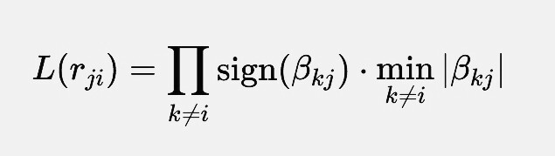
SOFT DECISION DECODING
Min Sum Approximation
Input:
Real values from channel are represented as soft bits (LLRs):
Step 3: Update Total LLR for Each Bit
Step 1: VN to CN Message(Current belief)
Bit Decision Rule:
ĉᵢ = 1, if L(Qi) < 0
0, else
Stopping Condition:
Max iterations done OR
H⋅ĈT = 0 (all parity checks satisfied)
Step 2: CN to VN Message (Min-Sum)

Slide 30
SOFT DECISION DECODING
Min Sum Approximation Algorithm
Storage matrix ℓ is a sparse matrix of same size as Parity Check Matrix.
ℓ(i,j)=0 if H(i,j)=0 and
ℓ(i,j) is non-zero only if H(i,j)=1
For Each Row:
Magnitude
min1 = minimum absolute value of all non-zero entries in row
min2 = next higher absolute value
Set magnitude of all values except minimum = min1
Set magnitude of minimum value = min2
Sign
Parity = Product of signs of entries in row
New sign of entry = (old sign) (parity)

Slide 31
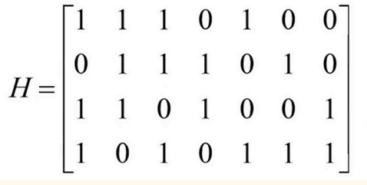
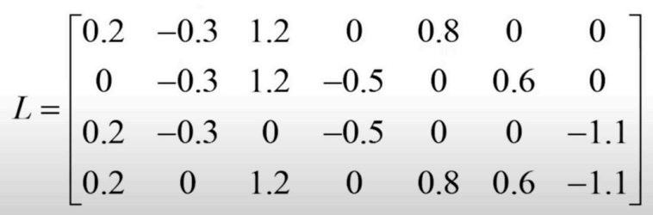
SOFT DECISION DECODING
Example

Slide 32
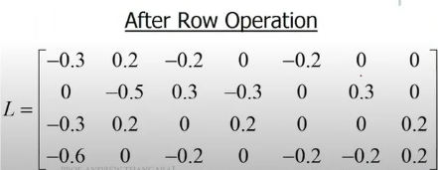
SOFT DECISION DECODING
Example

Slide 33
SOFT DECISION DECODING
Min Sum Approximation Algorithm
For Each Column
New Values
Sumj = rj + sum of all entries in column j.
New Entry = Sum - (Old Entry)
Sum is the new belief generated about values after the ith iteration
Decoding Values
If sumj > 0, decision on bit j = 0
If sumj < 0, decision on bit j = 1

Slide 34
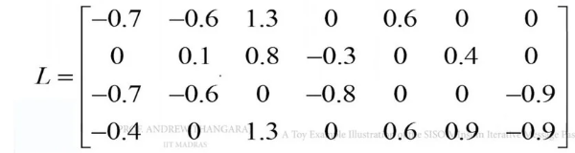
SOFT DECISION DECODING
Example
Updated
Belief
After Column Operation

Slide 35
RESULT OF
NR_2_6_52

Slide 36
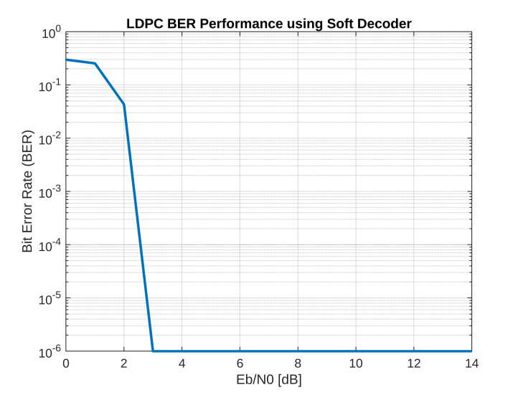
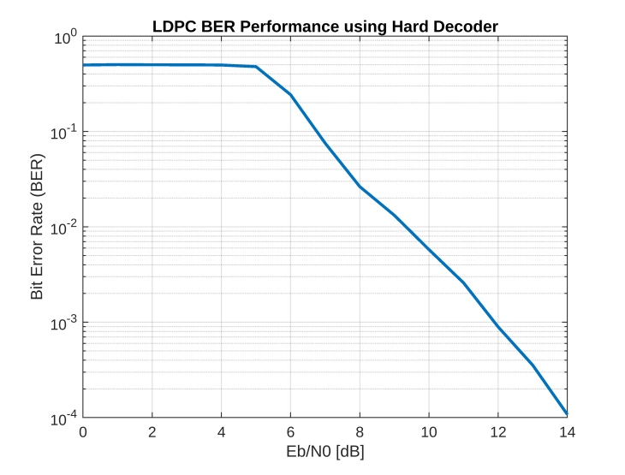
CODE RATE = 1/4
SOFT DECODING
HARD DECODING

Slide 37
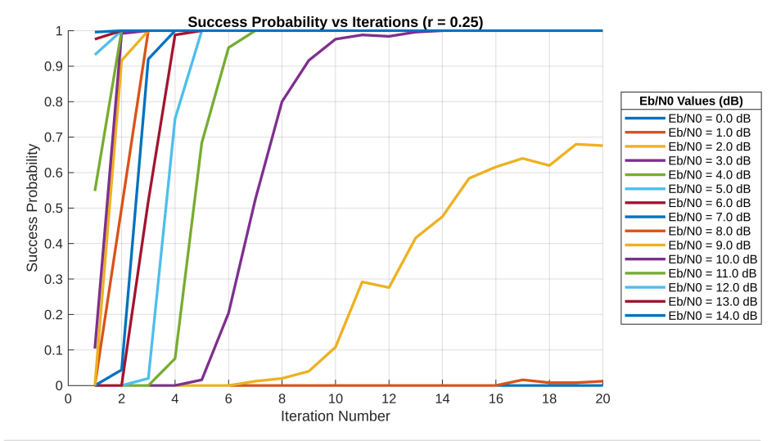
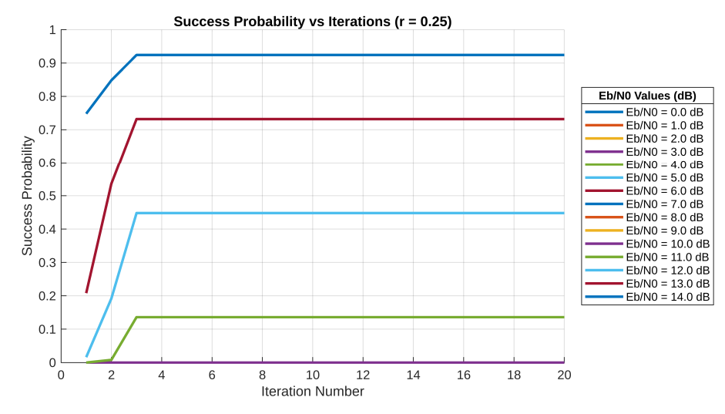
HARD DECODING
SOFT DECODING

Slide 38
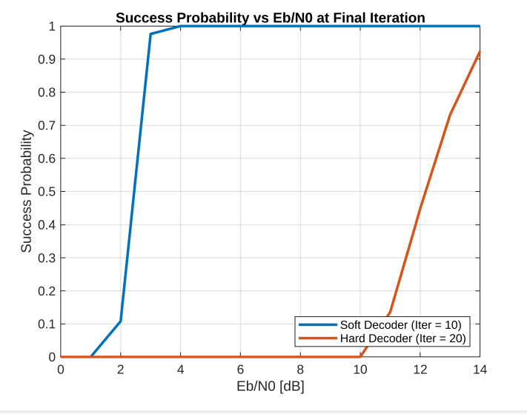

Slide 39
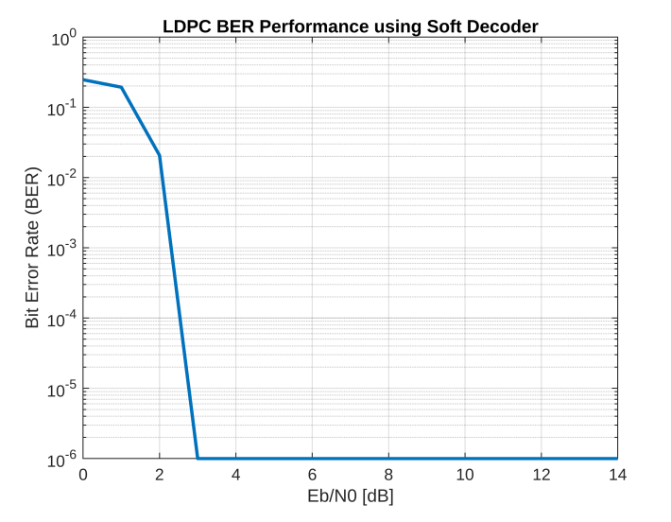
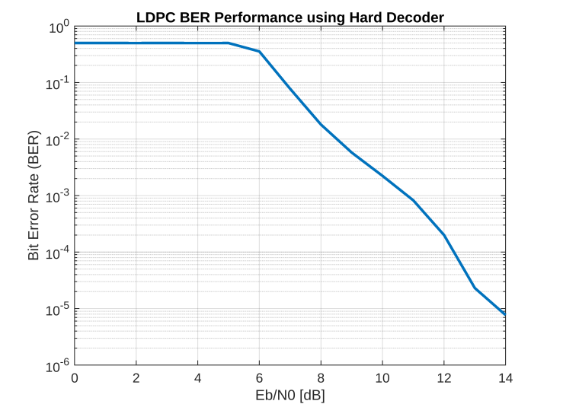
CODE RATE = 1/3
SOFT DECODING
HARD DECODING

Slide 40
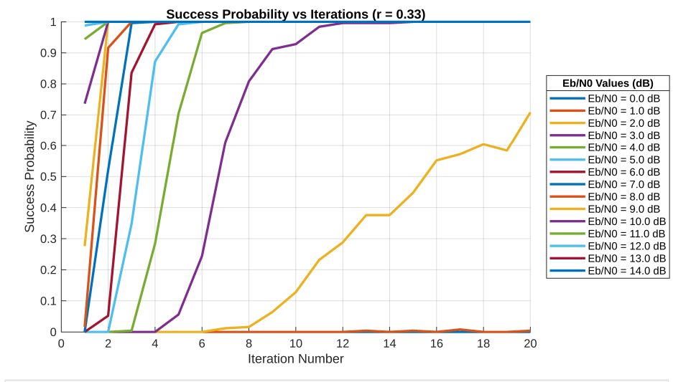
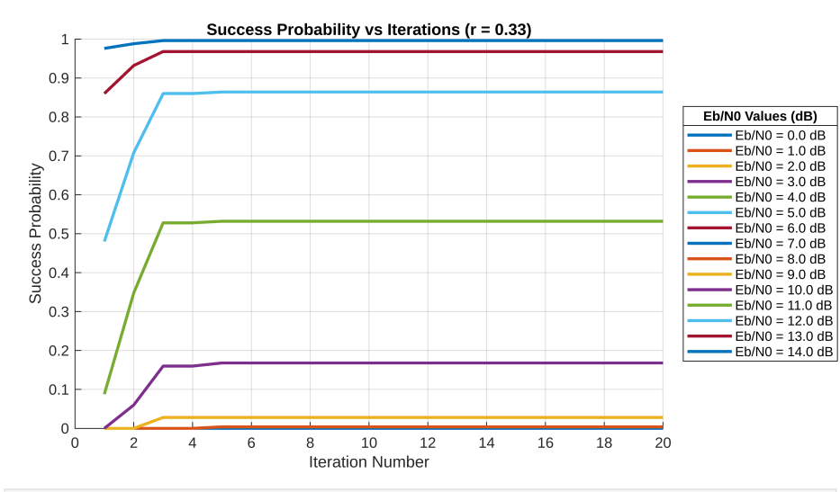
HARD DECODING
SOFT DECODING

Slide 41
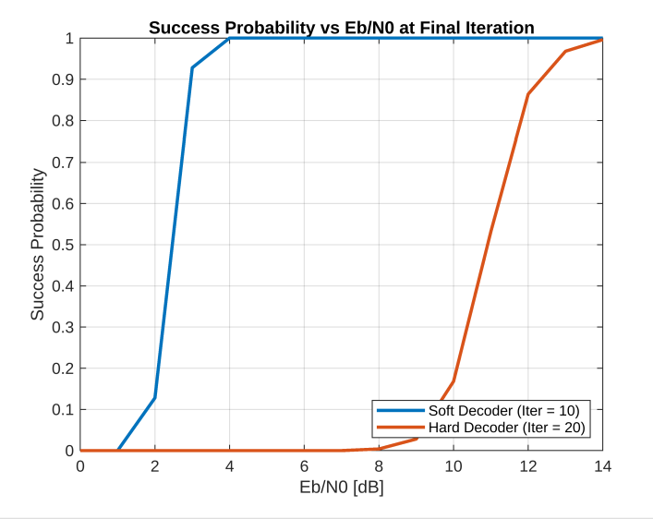

Slide 42
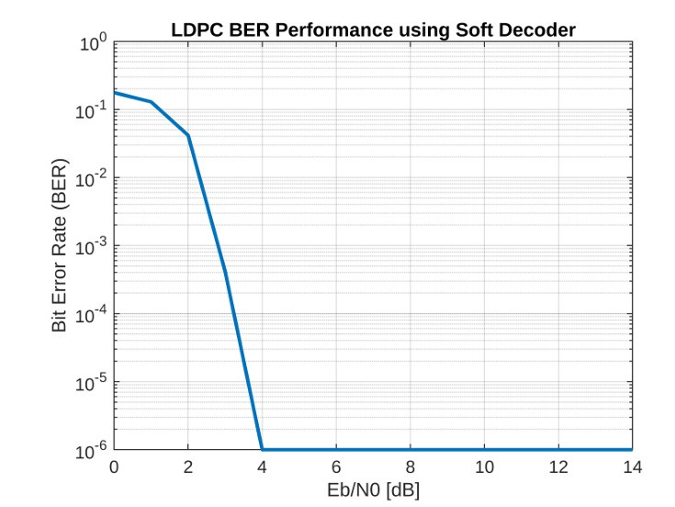
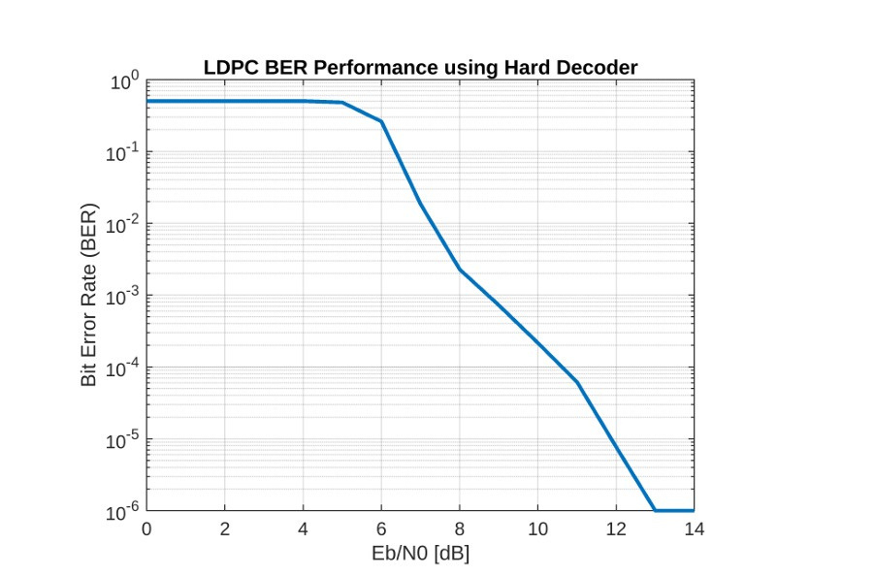
CODE RATE = 1/2
SOFT DECODING
HARD DECODING

Slide 43
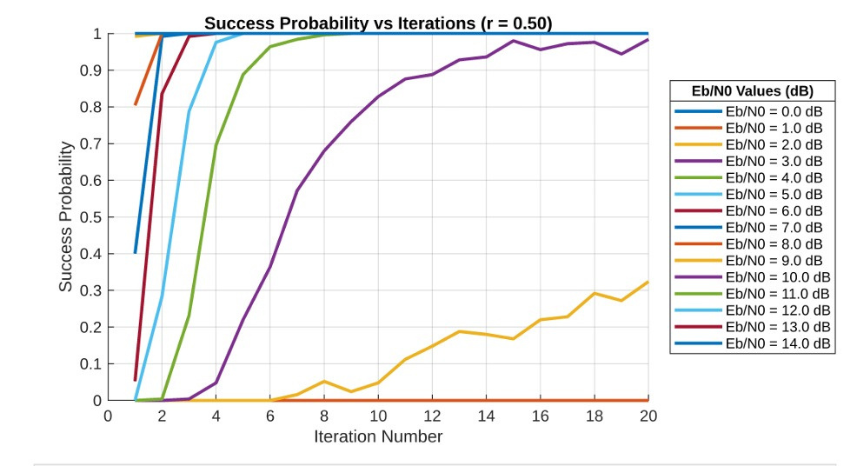
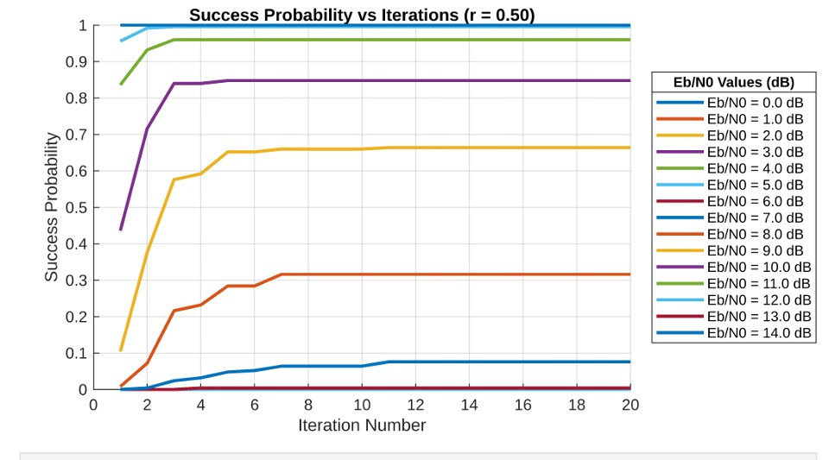
HARD DECODING
SOFT DECODING

Slide 44
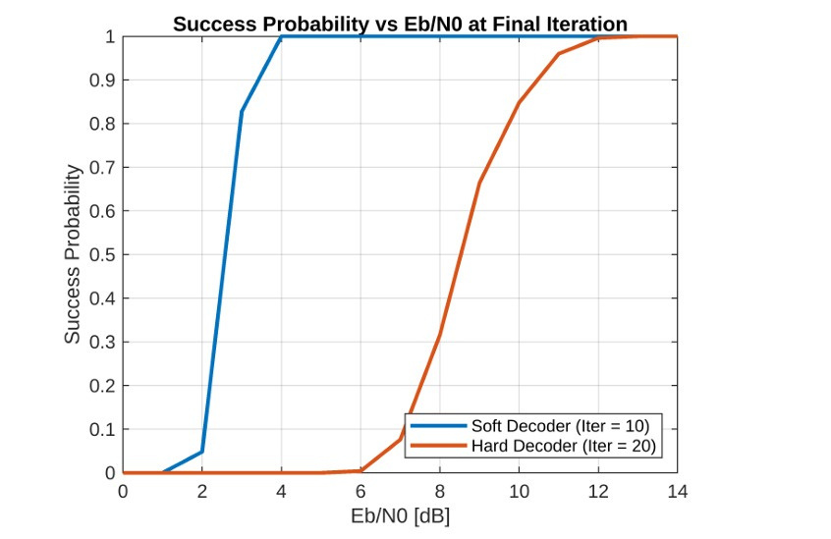

Slide 45
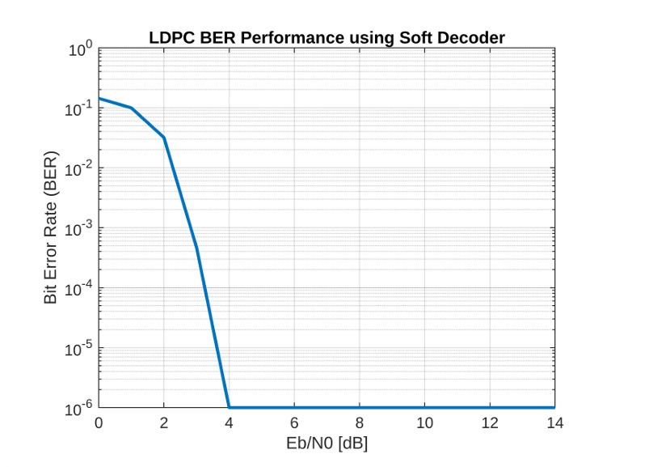
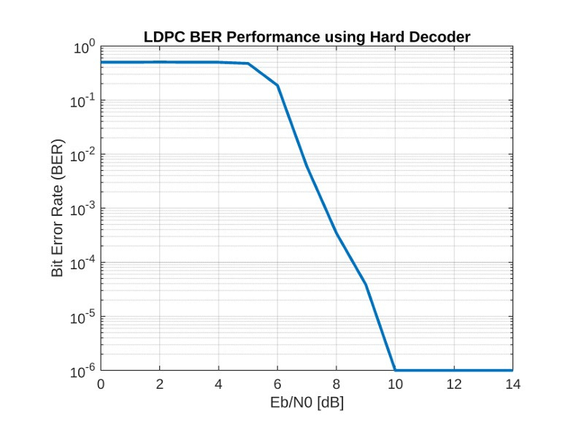
CODE RATE = 3/5
SOFT DECODING
HARD DECODING

Slide 46
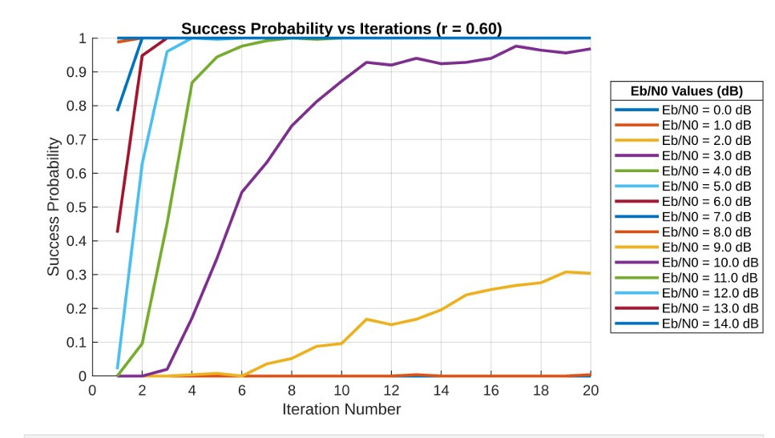

HARD DECODING
SOFT DECODING

Slide 47


Slide 48
RESULT OF
NR_1_5_352

Slide 49


CODE RATE = 1/3
SOFT DECODING
HARD DECODING

Slide 50


HARD DECODING
SOFT DECODING

Slide 51


Slide 52


CODE RATE = 1/2
SOFT DECODING
HARD DECODING

Slide 53


HARD DECODING
SOFT DECODING

Slide 54


Slide 55


CODE RATE = 3/5
SOFT DECODING
HARD DECODING

Slide 56


HARD DECODING
SOFT DECODING

Slide 57


Slide 58


CODE RATE = 4/5
SOFT DECODING
HARD DECODING

Slide 59


HARD DECODING
SOFT DECODING

Slide 60


Slide 61




SHANNON’S LIMIT

Slide 62
THANK YOU

